Slide 1
TsunamiLab
Project Report
Alexander Binsmaier,
Ludwig Peuckert

Slide 2
Dynamic Rupture Project
Current assumption:
  Displacement in bathymetry at timestep zero
  Tsunami wave initially is „like the displacement“
  This is an easy simplification to the actual origin of a tsunami

Slide 3
Dynamic Rupture Project
Goal:
  Tsunami is a consequence of a rupture
  => Create a wave by reading seismological data

Slide 4
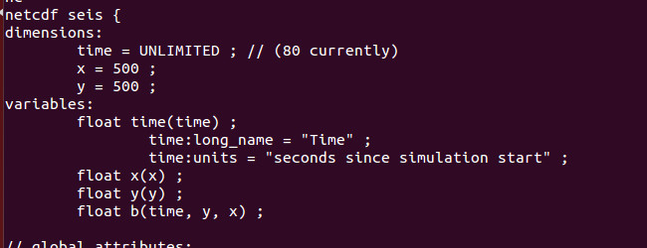
Dynamic Rupture Project
Implement a dynamic displacement reader
Solution: Scenario reading bathymetry file and displacement file. GetBathymetry additionally accepts time parameter

Slide 5
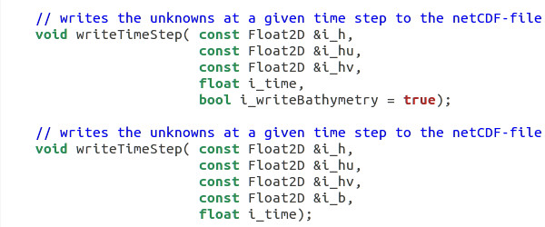
Dynamic Rupture Project
Adjust writer to write bathymetry time dependent
Changed writeTimestep to accept bathymetry parameter and write bathymetry as timedependent variable

Slide 6
Dynamic Rupture Project
Update Bathymetry
SWE_Block extended to support bathymetry updating

Slide 7
Dynamic Rupture Project
Usage
<executable> -x <val> -y <val> -i <input directory> [-s <seismology file>] […]
Creates a netCDF file as output and one as checkpoint scenario. Checkpointing for seismological data does not work though!

Slide 8
Dynamic Rupture Project

Slide 9
Dynamic Rupture Project

Slide 10
Dynamic Rupture Project

Slide 11
Dynamic Rupture Project

